Slide 1

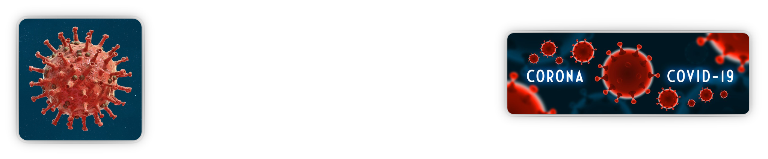


Dovato, nuevos datos post IAS/EACS.
Alella,14 de noviembre de 2023
Boris Revollo B. MD, PhD
Germans Trias i Pujol University Hospital
Infectious Diseases Department

Slide 2
Conflicts of interest
  Educational grants (HIV Unit): UAB, MAG, Primavera Sound group.
  Honoraria and travel sponsorship: Merck Sharp & Dohme, Gilead Sciences, Janssen, ViiV Healthcare.
  Co-investigator in clinical trials sponsored: Merck Sharp & Dohme, Gilead Sciences, Janssen, ViiV Healthcare
  Not a patent holder or a shareholder
  No disclosures for any family members

Slide 3
AGENDA
  Guidelines Update
  DTG/3TG in Treatment-Naïve “Special” People With HIV-1
  RWD reports of DTG/3TG Effectiveness in Treatment-Naive People With HIV-1 and Low TCD4+ or High Viral Load
  New data on switch treatment strategies
  Conclusions

Slide 4
Guidelines recommendations for Initial ART in adults. It’s not only yes or no.
DTG/3TC preferred in all guidelines.
ABC starting to be removed (IAS-USA, BHIVA).
RAL removed (IAS-USA, DHHS, GeSIDA).
Cortesía Dr. Llibre
Preferred/recommended
Recommended in certain clinical situations
 | DHHS March 23, 2023 “Recommended for most people” | EACS Oct 2023 “Recommended” | IAS-USA Dec 2022 “Recommended” | GESIDA 2022 “Preferred”
DTG/3TC | HBsAg negative HIV-VL < 500,000 copies/mL (limited data are available in patients with viral loads above > 500,000) Not for rapid start (TDR, HBV data) Not recommended after PrEP failure (CAB or TDF/FTC) | HBsAg negative HIV-VL < 500,000 copies/mL Not recommended after PrEP failure | HBsAg negative HIV-VL < 500,000 copies/mL Perhaps CD4 < 200 cells, unclear Not for rapid start (TDR) or after PReP failure or IOs. Close monitoring for adherence Cost or safety advantages over 3DR. Not recommended during pregnacy | HBsAg negative CD4 > 200 cells Not recommended after PrEP failure
DTG/ABC/3TC | HLA-B*57:01 negative HBsAg negative | HLA-B*57:01 negative HBsAg negative | OTHER Concerns with ABC and increased risk AMI HLA-B*57:01 negative HBsAg negative | HLA-B*57:01 negative HBsAg negative
TAF/FTC or TDF/XTC + DTG | TDF renal and bone toxicity but better lipid profile |  | TDF renal and bone toxicity TAF Associated with greater weight gain
BIC/FTC/TAF | Not recommended after CAB PrEP failure (INSTI genotiping) | Weight increase (BIC, TAF) | TAF associated with greater weight gain Not recommended during pregnacy
TAF/FTC or TDF/XTC + RAL | OTHER: No STR, lower resistance barrier, higher pill |  | OTHER: Only in pregnancy
TAF/FTC or TDF/XTC + DOR or TDF/3Tc/DOR
EACS Guidelines 12.0. October 2023. Available at: https://www. https://www.eacsociety.org/media/guidelines-12.0.pdf. IAS-USA Guidelines. Gandhi R. JAMA 2023; 329(1):63-84. doi:10.1001/jama.2022.22246. DHHS. Available at https://clinicalinfo.hiv.gov/en/guidelines/hiv-clinical-guidelines-adult-and-adolescent-arv/whats-new . Updated September 21, 2022. GeSIDA/PNS TAR en adultos infectados por el VIH (Actualización enero 2023). Disponible en: https://gesida-seimc.org

Slide 5
DTG + 3TC achieves virologic suppression at 48 weeks regardless of baseline viral load
GEMINI-1, GEMINI-2
DTG + 3TC (N=716)
DTG + TDF/FTC (N=717)
DTG + TDF/FTC
DTG + 3TC
526/576
531/564
–2.8
129/140
138/153
45/51
–0.9
41/46
16/18
20/24
11/13
12/15
–20
–10
Difference in proportion, % (95% CI)
Eron J, Hung C-C, Baril J-G, et al. Virologic Response by Baseline Viral Load With Dolutegravir Plus Lamivudine vs Dolutegravir Plus Tenofovir Disoproxil Fumarate/Emtricitabine Pooled Analysis. J Acquir Immune Defic Syndr. 2020 Jan.
Notes:
This data demonstrates that high barrier to resistance agents such a DTG, LPV/r and DRV/r require multiple mutations to fail.
For example DTG, requires a Q148H/K/R mutation plus 2 or more additional INI resistance mutations including such as G140A/C/S, E138A/K/T, or L74I to achieve phenotypic resistance. This is a significant genetic barrier for the virus it also incurs a fitness loss down the resistance pathway.
DTG, LPV/r and DRV/r are also very potent drugs with high inhibitory quotients which make it hard for the virus to select mutations which replicate in-vivo in the presence of the drug
A recent literature summary (Cevik 2020) identified only 5 cases of VF with resistance in naïve and 10 in treatment experienced. Of the 15 cases, 10 had either suboptimal DTG levels when they were measured or had documented poor adherence, and 3 had advanced HIV and severe active infections. The key point, failure with a DTG based regimen either 3DR or 2DR is extremely rare.

Slide 6
Gemini 1 and 2 : Pooled Outcomes at Week 48 Stratified by Baseline HIV-1 RNA and CD4+ Cell Count: Snapshot Analysis
Snapshot Analysis
TRDF Analysis
526
576
531
564
129
140
138
153
605
653
618
662
50
63
51
55
566
576
553
564
138
140
149
153
642
653
647
662
62
63
55
55
≤100,000
>100,000
>200
≤200
≤100,000
>100,000
>200
≤200
Baseline HIV-1
RNA, c/mL
Baseline CD4+
cell count, cell/mm³
Baseline HIV-1
RNA, c/mL
Baseline CD4+
cell count, cell/mm³
 | DTG + 3TC |  | DTG + TDF/FTC
2% of participants in each arm had baseline HIV-1 RNA >500,000 c/mL
Treatment related discontinuation = failure (TRDF) population accounts for confirmed virologic withdrawal (CVW), withdrawal
due to lack of efficacy, withdrawal due to treatment-related AE, and participants who met protocol-defined stopping criteria
DTG + 3TC CD4 <200 Snapshot non-response (n=13): 1 CVW, 3 with VL >50 in window (2 of 3 re-suppressed), 2 discontinued due to AE (TB, Chagas disease), 2 protocol violations, 2 lost to follow-up, 1 withdrew consent, 1 withdrew to start HCV treatment, 1 change in ART (incarcerated)
DTG + TDF/FTC < 200 Snapshot non-response (n=4):1 investigator discretion, 1 withdrew consent, 1 lost to follow-up, 1 VL >50 (re-suppressed)
Cahn P et al. The Lancet, January 12, 2019

Slide 7
Gemini 1 and 2 : Confirmed Virologic Withdrawals Through Week 48: ITT-E Population
Low rates of virologic withdrawals were observed at Week 48
 | GEMINI 1 |  | GEMINI 2 |  | Pooled
Variable, n (%) | DTG + 3TC (N=356) | DTG + TDF/FTC (N=358) | DTG + 3TC (N=360) | DTG + TDF/FTC (N=359) | DTG + 3TC (N=716) | DTG + TDF/FTC (N=717)
CVW | 4 (1) | 2 (<1) | 2 (<1) | 2 (<1) | 6 (<1) | 4 (<1)
Treatment-emergent resistance | 0 | 0 | 0 | 0 | 0 | 0
No treatment-emergent INSTI mutations or NRTI mutations were observed among participants who met CVW (confirmed virologic failure) criteria
Confirmed virologic withdrawal criteria is defined as a second and consecutive HIV-1 RNA value meeting virologic non-response or rebound. Virologic non-response is defined as either a decrease in plasma HIV-1 RNA of less than 1 log₁₀ c/mL by Week 12 with subsequent confirmation unless plasma HIV-1 RNA is <200 c/mL, or confirmed plasma HIV-1 RNA levels ≥200 c/mL on or after Week 24. Virologic rebound is defined as confirmed rebound in plasma HIV-1 RNA levels to ≥200 c/mL after prior confirmed suppression to <200 c/mL.
.
Cahn P et al. The Lancet, January 12, 2019

Slide 8
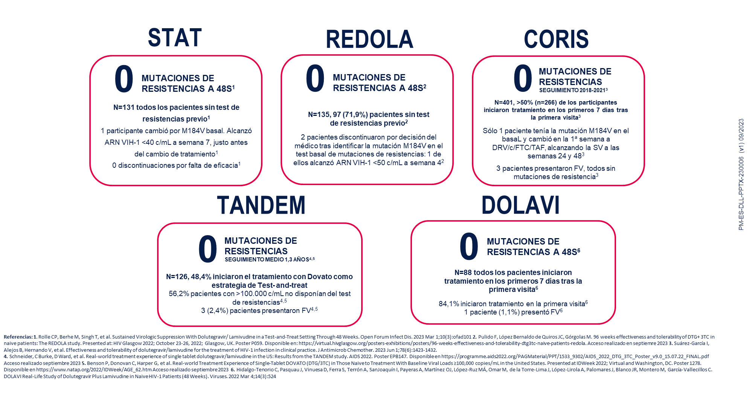
Slim et al. IDWeek 2023; Boston, MA. Poster 1593.

Slide 9
DTG/3TC in a Test-and-Treat Setting
Rolle CP et al, Open Forum Infectious Diseases 1 March 2023

Slide 10
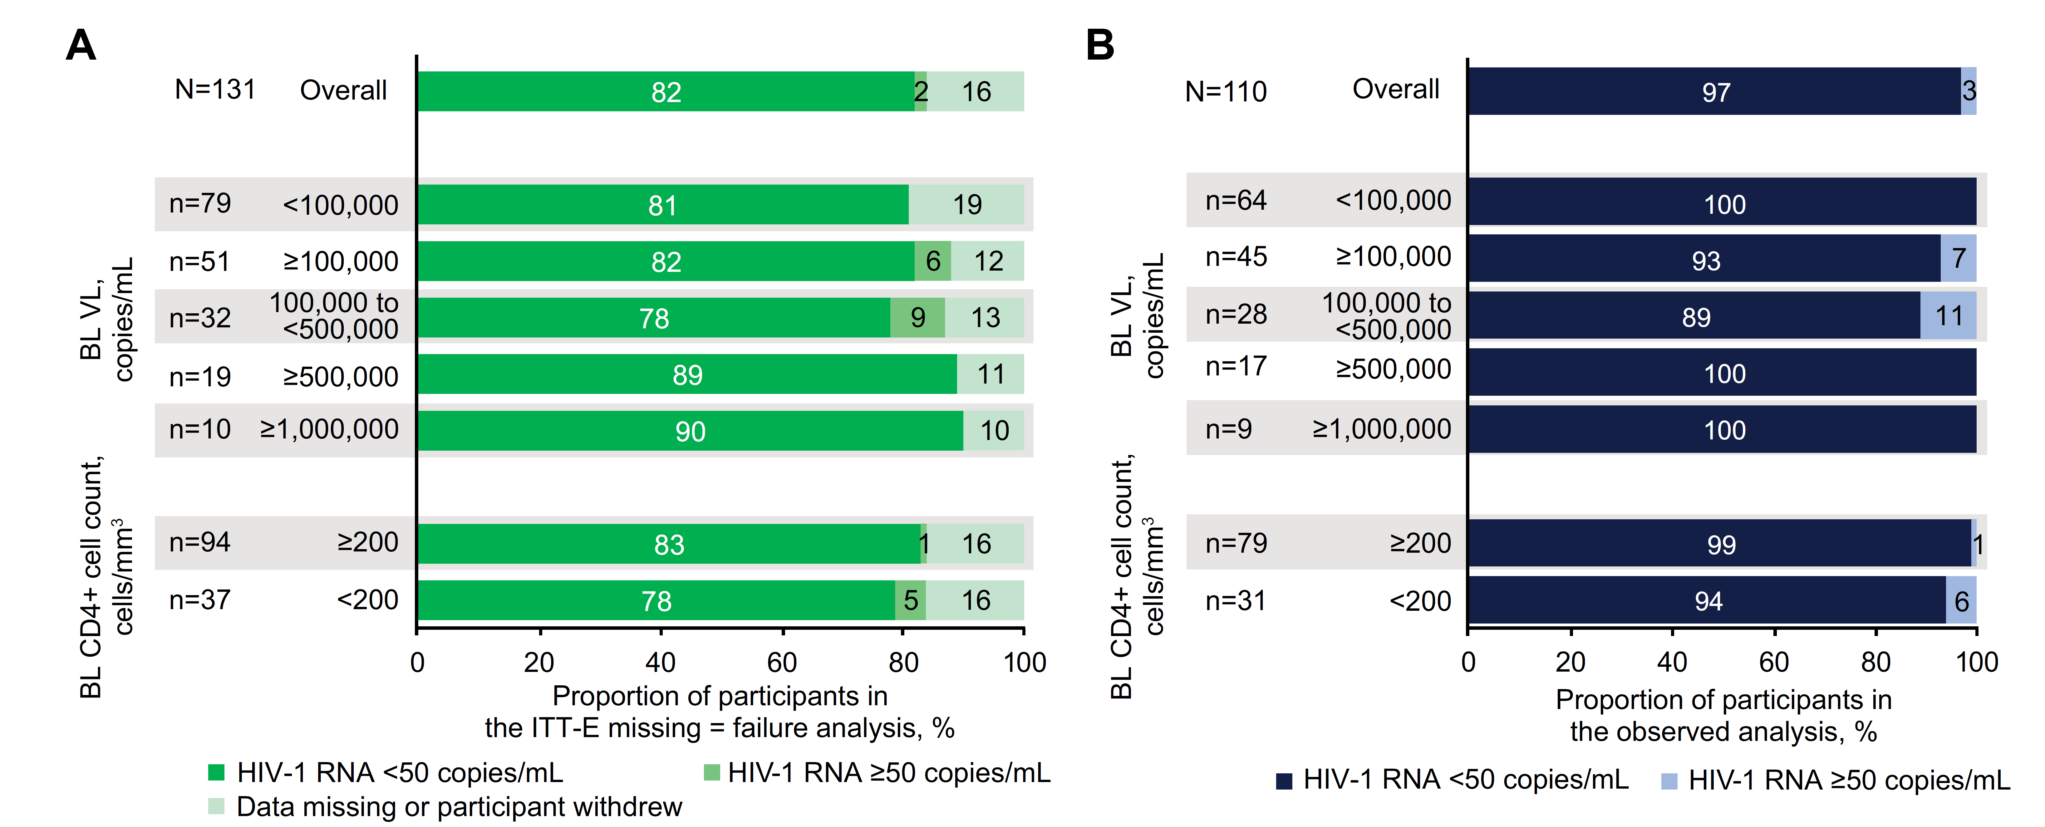
DTG/3TC in a Test-and-Treat Setting
Rolle CP et al, Open Forum Infectious Diseases 1 March 2023

Slide 11
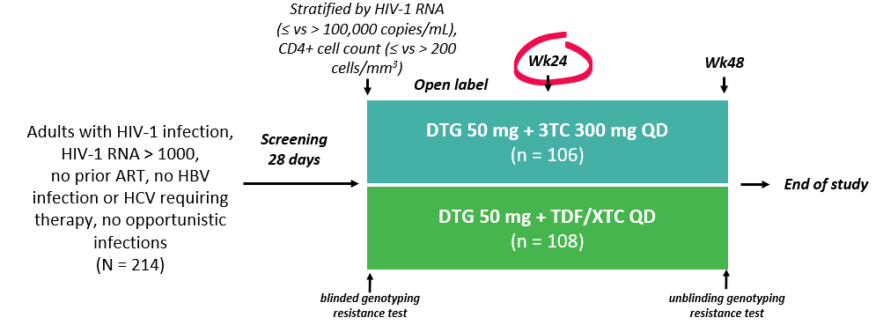
D2ARLING Study Design
Study Objectives
Assess the efficacy and safety of DTG+3TC in treatment-naïve PLHIV without baseline HIV-1 resistance testing
Out of 244 subjects screened, 214 were randomized to receive DTG+3TC (n=106) or DTG+TDF/XTC (n=108)
Cordova et al. IAS 2023; Brisbane, Australia. Poster TUPEB02.

Slide 12
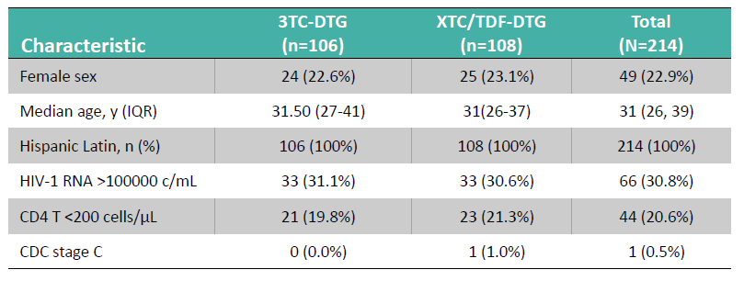
Demographics and Clinical Baseline Characteristics in the ITT-Exposed Population
Baseline characteristics were similar between arms
Cordova et al. IAS 2023; Brisbane, Australia. Poster TUPEB02.

Slide 13
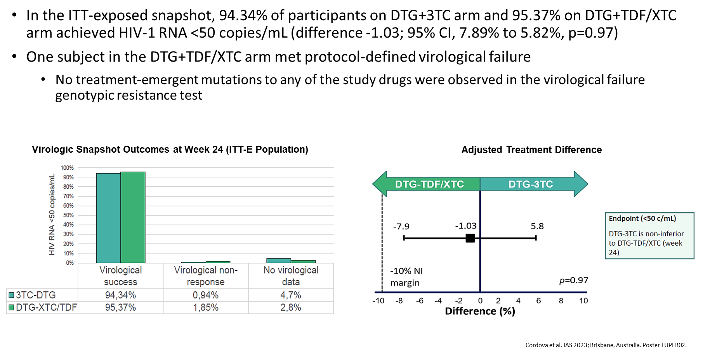
Virologic Results
Cordova et al. IAS 2023; Brisbane, Australia. Poster TUPEB02.

Slide 14
DOLAM-500: Efficacy and safety of Dolutegravir (DTG) plus Lamivudine (3TC) in ART-naive PLWH with baseline viral load ≥500.000 copies/ml
Inan A et al. EACS 2023; Warsaw, Poland. Poster 190

Slide 15
Real-world Effectiveness of Dolutegravir + Lamivudine (DTG + 3TC) in Treatment-Naive People With HIV-1 and Low CD4+ Cell Count or High Viral Load at Baseline: A Systematic Literature Review
Emilio Letang,¹ Tristan J. Barber,^{2,3} Clotilde Allavena,⁴ Laurent Hocqueloux,⁵ José Casado,⁶
Simona Di Giambenedetto,⁷ Alfonso Cabello-Úbeda,⁸ Antonella d’Arminio Monforte,⁹
Madhusudan Kabra,¹⁰ Julie Priest,¹¹ Ana Milinkovic,¹⁰ Bryn Jones¹⁰
¹ViiV Healthcare, Madrid, Spain; ²Ian Charleson Day Centre, Royal Free London NHS Foundation Trust, London, UK; ³Institute for Global Health, University College London, London, UK; ⁴CHU Hôtel-Dieu, Nantes, France; ⁵Centre Hospitalier Universitaire d’Orléans, Orléans, France; ⁶Hospital Universitario Ramón y Cajal, Madrid, Spain; ⁷Fondazione Policlinico Universitario Agostino Gemelli IRCCS and Università Cattolica del Sacro Cuore, Rome, Italy; ⁸Fundación Jimenez Diaz University Hospital, Madrid, Spain; ⁹‘San Paolo’ Hospital, University of Milan, Milan, Italy; ¹⁰ViiV Healthcare, Brentford, UK; ¹¹ViiV Healthcare, Durham, NC, USA
Letang et al. EACS 2023; Warsaw, Poland. Poster eP.A.050.

Slide 16
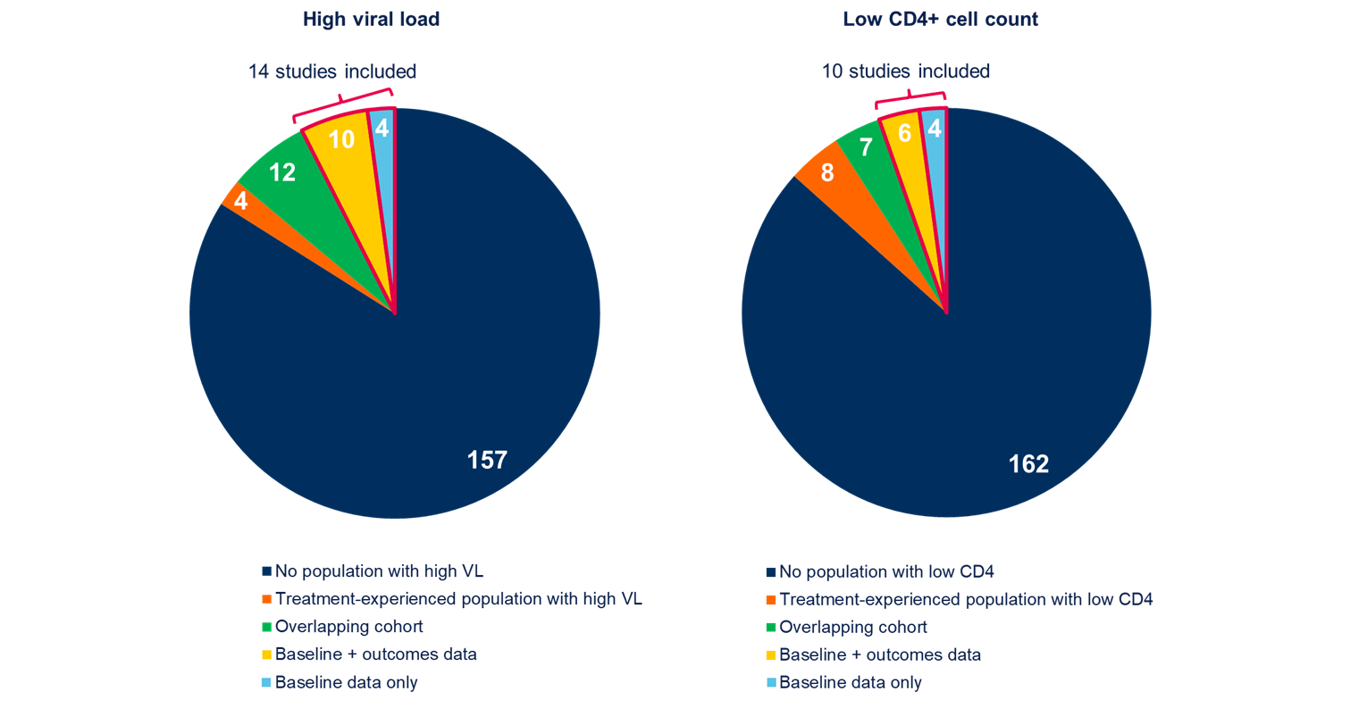
Breakdown of Real-world Publications Reporting Data on People With HIV-1 Initiating DTG + 3TC With Viral Load ≥100,000 Copies/mL and CD4+ Cell Count <200 Cells/mm³
Letang et al. EACS 2023; Warsaw, Poland. Poster eP.A.050.

Slide 17
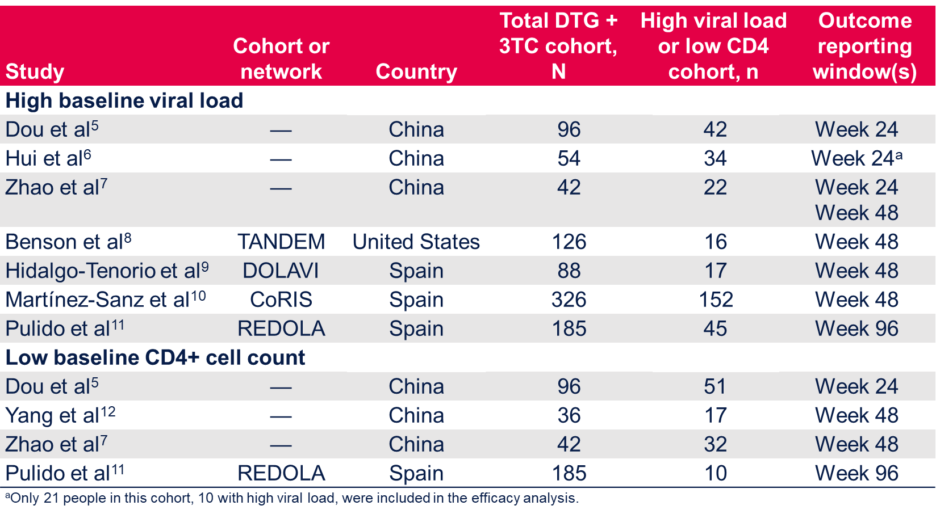
Studies With Virologic Effectiveness Data for ≥10 Treatment-Naive People With HIV-1 and Baseline Viral Load ≥100,000 Copies/mL or CD4+ Cell Count <200 Cells/mm3
7 and 4 studies reported the virologic effectiveness of DTG + 3TC for ≥10 treatment-naive individuals with high baseline viral load or low baseline CD4+ cell count, respectively
Letang et al. EACS 2023; Warsaw, Poland. Poster eP.A.050.
17
Letang et al. EACS 2023; Warsaw, Poland. Poster eP.A.050.

Slide 18
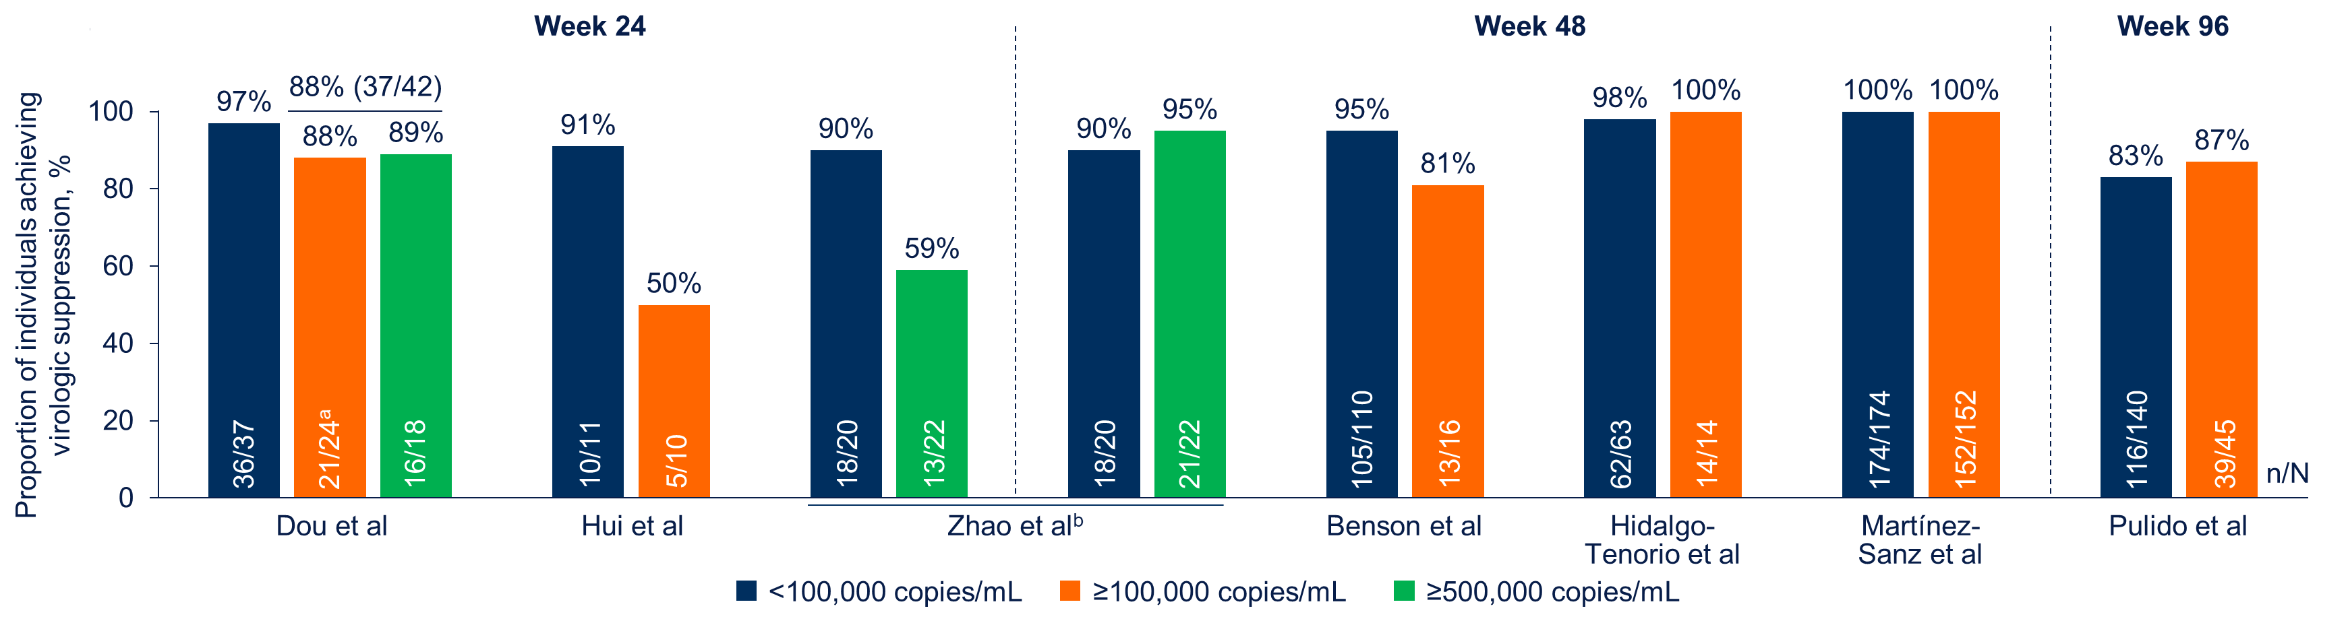
Proportions of Individuals With Baseline Viral Load ≥100,000 Copies/mL Achieving Virologic Suppression at Weeks 24, 48, and 96
Letang et al. EACS 2023; Warsaw, Poland. Poster eP.A.050.

Slide 19
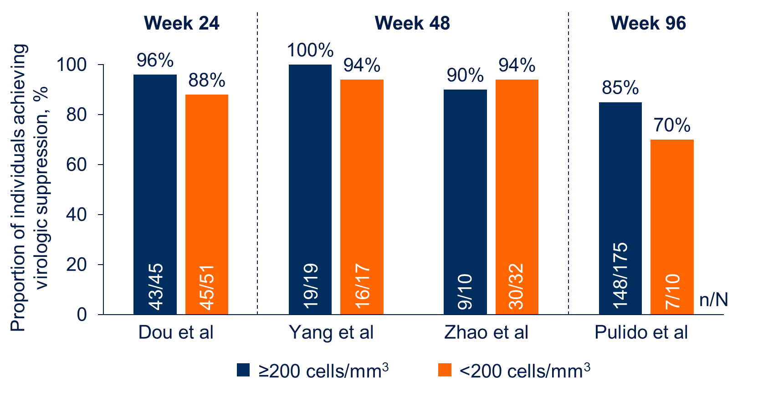
Proportion of Individuals With Baseline CD4+ Cell Count <200 Cells/mm³ Achieving Virologic Suppression at Weeks 24, 48, and 96
Letang et al. EACS 2023; Warsaw, Poland. Poster eP.A.050.

Slide 20
Virologic Outcomes in Treatment-Naive Populations With High Baseline Viral Load
Overall, the proportion of individuals with high baseline viral load who achieved virologic suppression was 76% (61/80) at Week 24, 97% (208/215) at Week 48, and 87% (39/45)
at Week 96
Among studies reporting data for ≥10 individuals with high baseline viral load from the same cohort, the proportion with HIV-1 RNA <50 copies/mL ranged from 50% (5/10) to 88% (37/42)
at Week 24 and from 81% (13/16) to 100% (152/152) at Week 48; at Week 96, one study reported that 87% (39/45) of individuals were virologically suppressed
  In a longitudinal cohort study following individuals with baseline viral load ≥500,000 copies/mL, the proportion achieving virologic suppression increased from 59% (13/22) at Week 24 to 95% (21/22) at Week 48
Using inverse-variance weighting methods with a correction of 0.01% for studies with 100% suppression, the pooled proportions of individuals with high baseline viral load from studies with
n ≥10 who achieved virologic suppression were 80.3% at Week 24, >99.9% at Week 48, and 87% at Week 96
Letang et al. EACS 2023; Warsaw, Poland. Poster eP.A.050.
Letang et al. EACS 2023; Warsaw, Poland. Poster eP.A.050.

Slide 21
Optimizing Antiretroviral Therapy in the Setting of Viral Suppression.
Preferred/recommended
Recommended in certain clinical situations
Maintain virological suppression without jeopardizing future treatment options
It is critical to review ART history
In the settings of existing NRTI resistance, should be included in the regimen with a fully active and high barrier drugs (DTG, BIC, boost DRV
 | DHHS March 23, 2023 “Recommended for most people” | EACS Oct 2023 “Recommended” | IAS-USA Dec 2022 “Recommended” | GESIDA 2022 “Preferred”
DTG/3TC | HBsAg negative From TDF From NNRTI From RAL From PI | HBsAg negative HIV-VL < 500,000 copies/mL Not recommended after PrEP failure | HBsAg negative HIV-VL < 500,000 copies/mL Perhaps CD4 < 200 cells, unclear Not for rapid start (TDR) or after PReP failure or IOs. Close monitoring for adherence Cost or safety advantages over 3DR. Not recommended during pregnacy | AI HBsAg negative From any 3DR that contain (NNRTI, 2 NRTI, PI or INI)
DTG/RPV | HBsAg negative From TDF From NNRTI From PI | HLA-B*57:01 negative HBsAg negative | OTHER Concerns with ABC and increased risk AMI HLA-B*57:01 negative HBsAg negative | AI HBsAg negative
BIC/FTC/TAF DTG/ABC/3TC* | From TDF or ABC From TDF From NNRTI From PI From RAL, EVG/c or DTG |  | TDF renal and bone toxicity TAF Associated with greater weight gain | AI
TAF | From TDF or ABC | Weight increase (BIC, TAF) | TAF associated with greater weight gain Not recommended during pregnacy
DOR or RPV | From efavirenz From PI |  | OTHER: Only in pregnancy
* GESIDA guidelines
EACS Guidelines 12.0. October 2023. Available at: https://www. https://www.eacsociety.org/media/guidelines-12.0.pdf. IAS-USA Guidelines. Gandhi R. JAMA 2023; 329(1):63-84. doi:10.1001/jama.2022.22246. DHHS. Available at https://clinicalinfo.hiv.gov/en/guidelines/hiv-clinical-guidelines-adult-and-adolescent-arv/whats-new . Updated September 21, 2022. GeSIDA/PNS TAR en adultos infectados por el VIH (Actualización enero 2023). Disponible en: https://gesida-seimc.org

Slide 22
Switch to DOVATO in Patients Suppressed on Biktarvy (The SOUND Study), Week 48 Interim Analysis
Study Objective
To report results from the Week 48 interim analysis of the SOUND study, evaluating virologically suppressed patients on bictegravir/emtricitabine/tenofovir-alafenamide (B/F/TAF) who were switched to DTG/3TC
Inclusion criteria:
  HIV VL < 50 copies/ml for ≥ 6 months
  Taking B/F/TAF ≥24 weeks
  No known resistance testing, no history of virological failure in prior 12 months
Primary end point:
  % of patients with HIV-1 VL ≥ 50 copies/mL at week 48
Secondary end points:
  At weeks 48 and 96 include: percentage of patients with HIV-1 VL < 50 copies/mL
  Incidence and severity of adverse events (AEs) and laboratory abnormalities
  % of subjects who discontinued treatment due to AEs
  Change in baseline CD4 cell count at week 48 and 96
  Retrospective pro-viral DNA testing on banked samples at baseline to compare virologic outcome (with or without M184V/I)
  Number and type of resistance-associated mutations in virologic failure
Slim et al. IDWeek 2023; Boston, MA. Poster 1593.

Slide 23
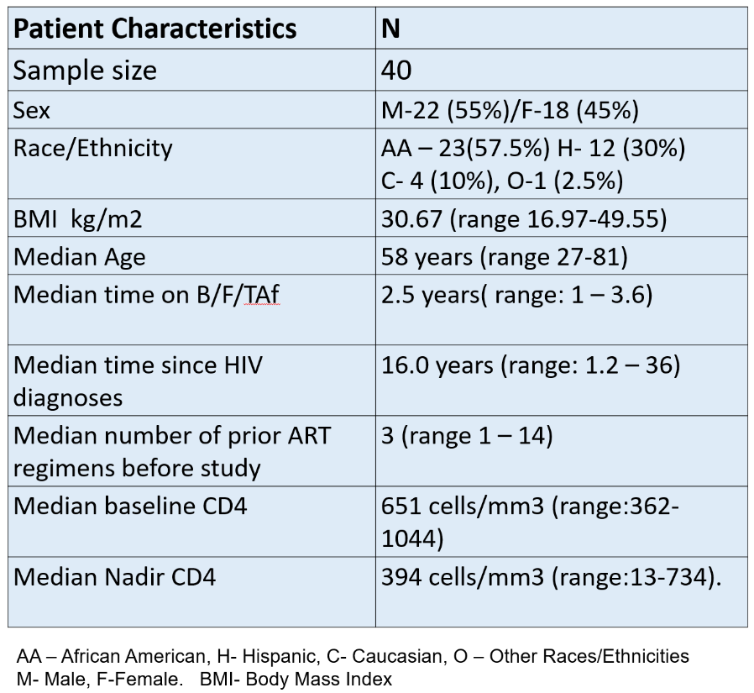
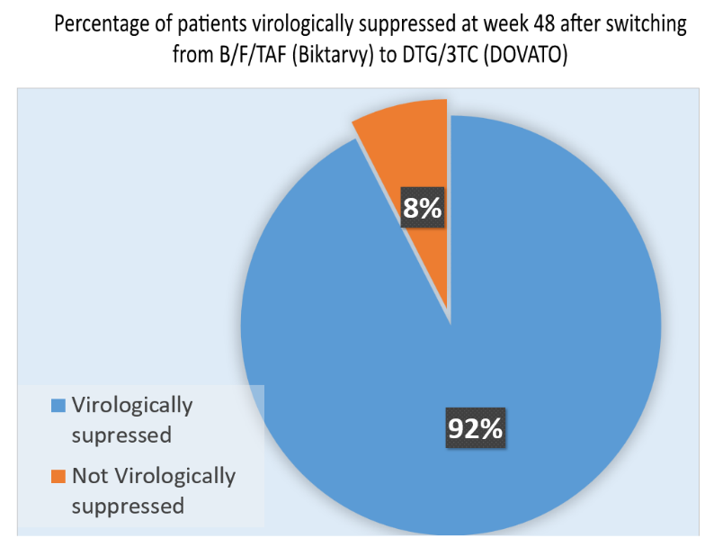
Switch to DOVATO in Patients Suppressed on Biktarvy (The SOUND Study), Week 48 Interim Analysis
Slim et al. IDWeek 2023; Boston, MA. Poster 1593.

Slide 24
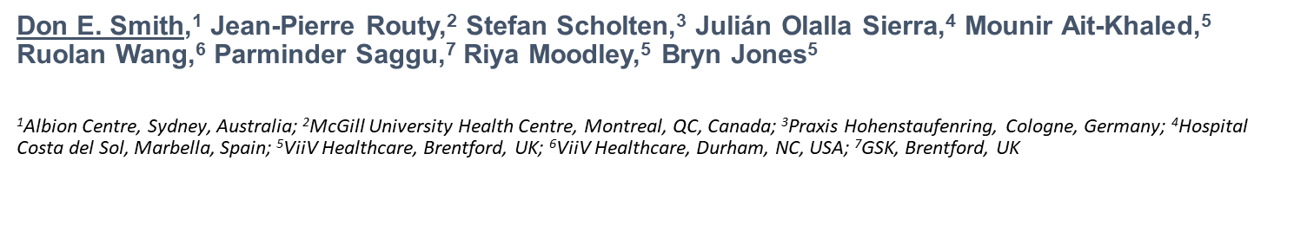
Switching to Dolutegravir/Lamivudine (DTG/3TC) Is Non-inferior to Continuing Tenofovir Alafenamide (TAF)-Based Regimens at Week 196: TANGO Subgroup Analyses
Referencia: 1. Smith D.E., Routy J.-P., Scholten S., et al. Switching to Dolutegravir/Lamivudine (DTG/3TC) is non-inferior to continuing tenofovir alafenamide (TAF)-based regimens at Week 196: TANGO subgroup analyses. Poster EPB0218. Presentado en IAS 2023, the 12th IAS Conference on HIV Science. 23–26 Julio 2023. Brisbane, Australia. Disponible en: https://www.natap.org/2023/IAS/IAS_27.htm Acceso realizado septiembre 2023

Slide 25
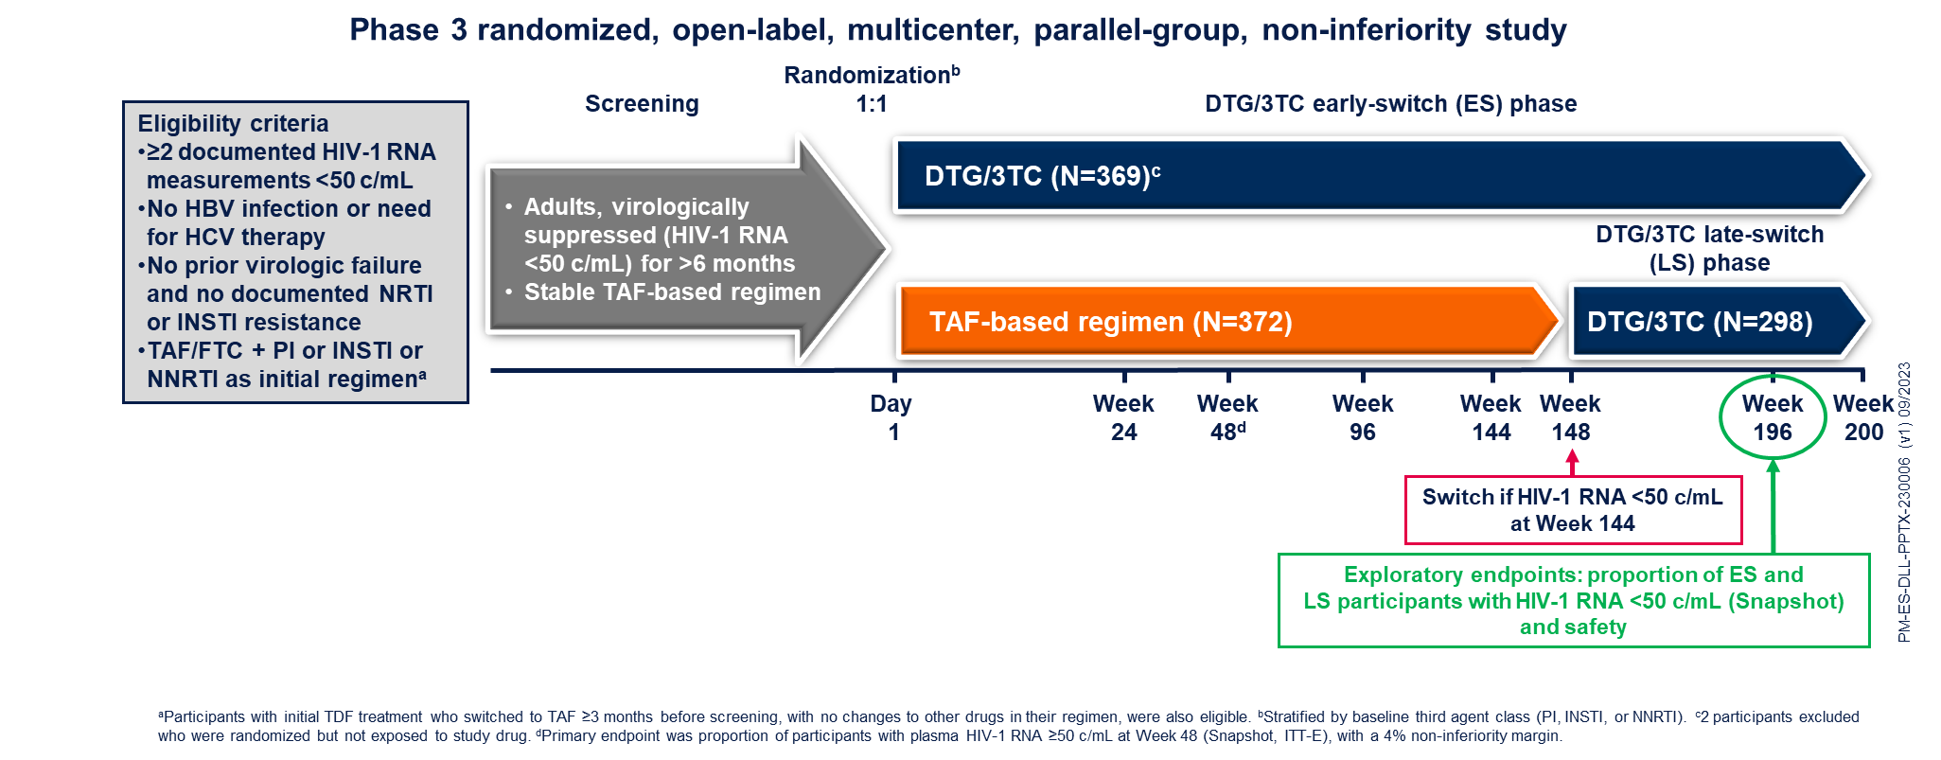
TANGO Study Design
Referencia: 1. Smith D.E., Routy J.-P., Scholten S., et al. Switching to Dolutegravir/Lamivudine (DTG/3TC) is non-inferior to continuing tenofovir alafenamide (TAF)-based regimens at Week 196: TANGO subgroup analyses. Poster EPB0218. Presentado en IAS 2023, the 12th IAS Conference on HIV Science. 23–26 Julio 2023. Brisbane, Australia. Disponible en: https://www.natap.org/2023/IAS/IAS_27.htm Acceso realizado septiembre 2023

Slide 26
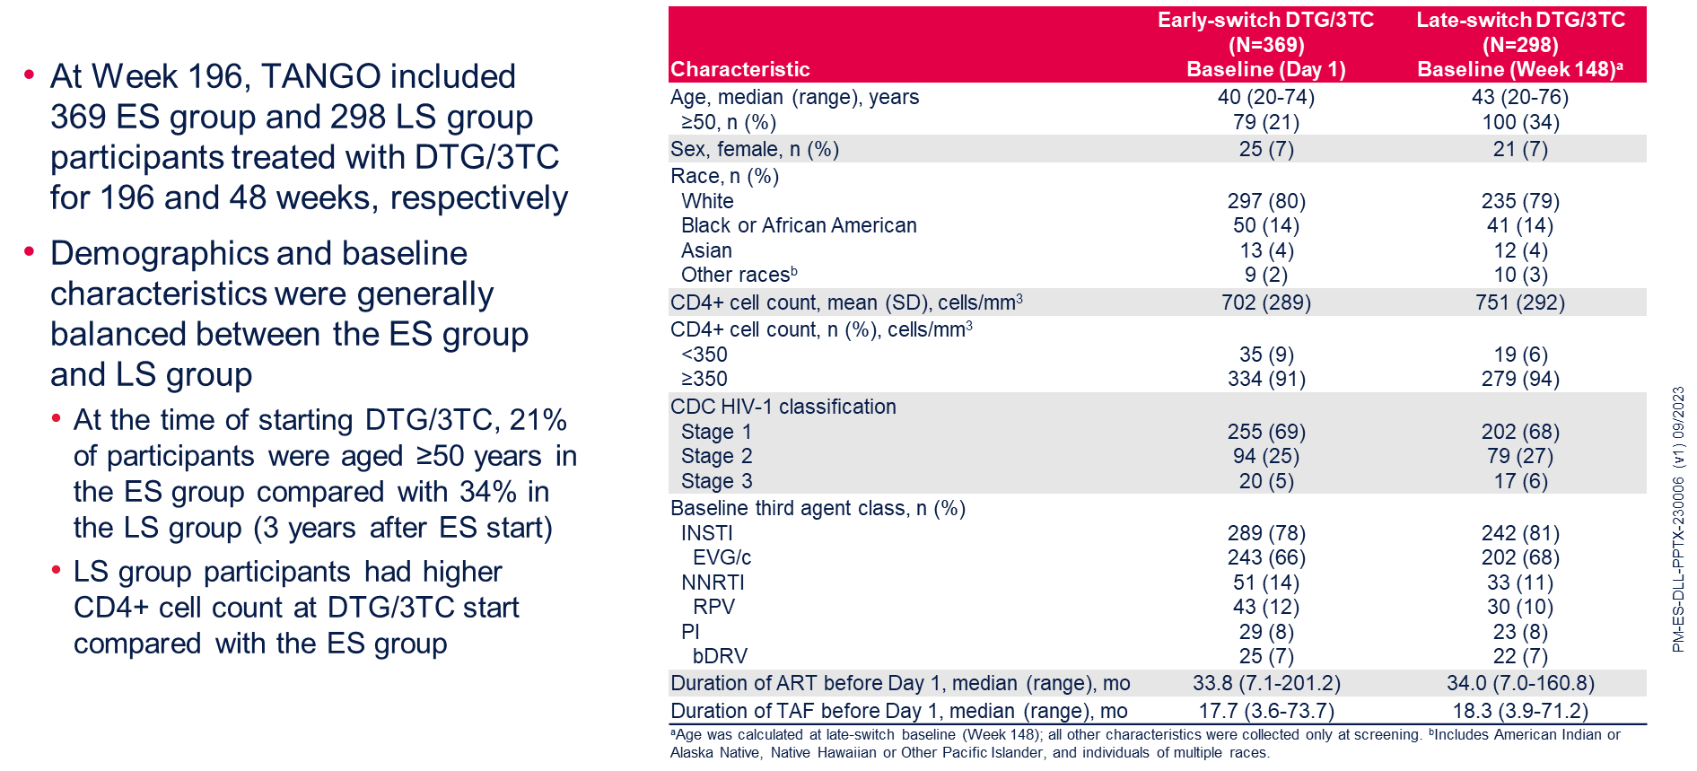
Participant Demographics and Baseline Characteristics (ITT-E Population)
Referencia: 1. Smith D.E., Routy J.-P., Scholten S., et al. Switching to Dolutegravir/Lamivudine (DTG/3TC) is non-inferior to continuing tenofovir alafenamide (TAF)-based regimens at Week 196: TANGO subgroup analyses. Poster EPB0218. Presentado en IAS 2023, the 12th IAS Conference on HIV Science. 23–26 Julio 2023. Brisbane, Australia. Disponible en: https://www.natap.org/2023/IAS/IAS_27.htm Acceso realizado septiembre 2023

Slide 27
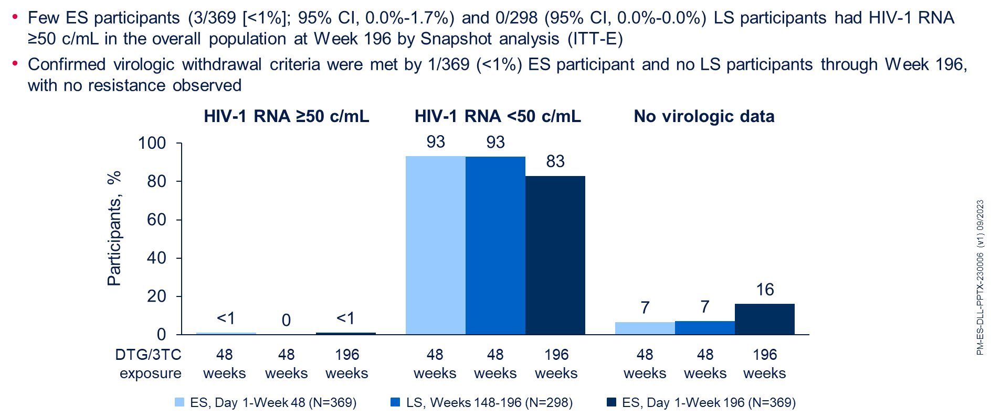
Overall Efficacy Results at Week 196 (Snapshot, ITT-E Population)
Referencia: 1. Smith D.E., Routy J.-P., Scholten S., et al. Switching to Dolutegravir/Lamivudine (DTG/3TC) is non-inferior to continuing tenofovir alafenamide (TAF)-based regimens at Week 196: TANGO subgroup analyses. Poster EPB0218. Presentado en IAS 2023, the 12th IAS Conference on HIV Science. 23–26 Julio 2023. Brisbane, Australia. Disponible en: https://www.natap.org/2023/IAS/IAS_27.htm Acceso realizado septiembre 2023

Slide 28
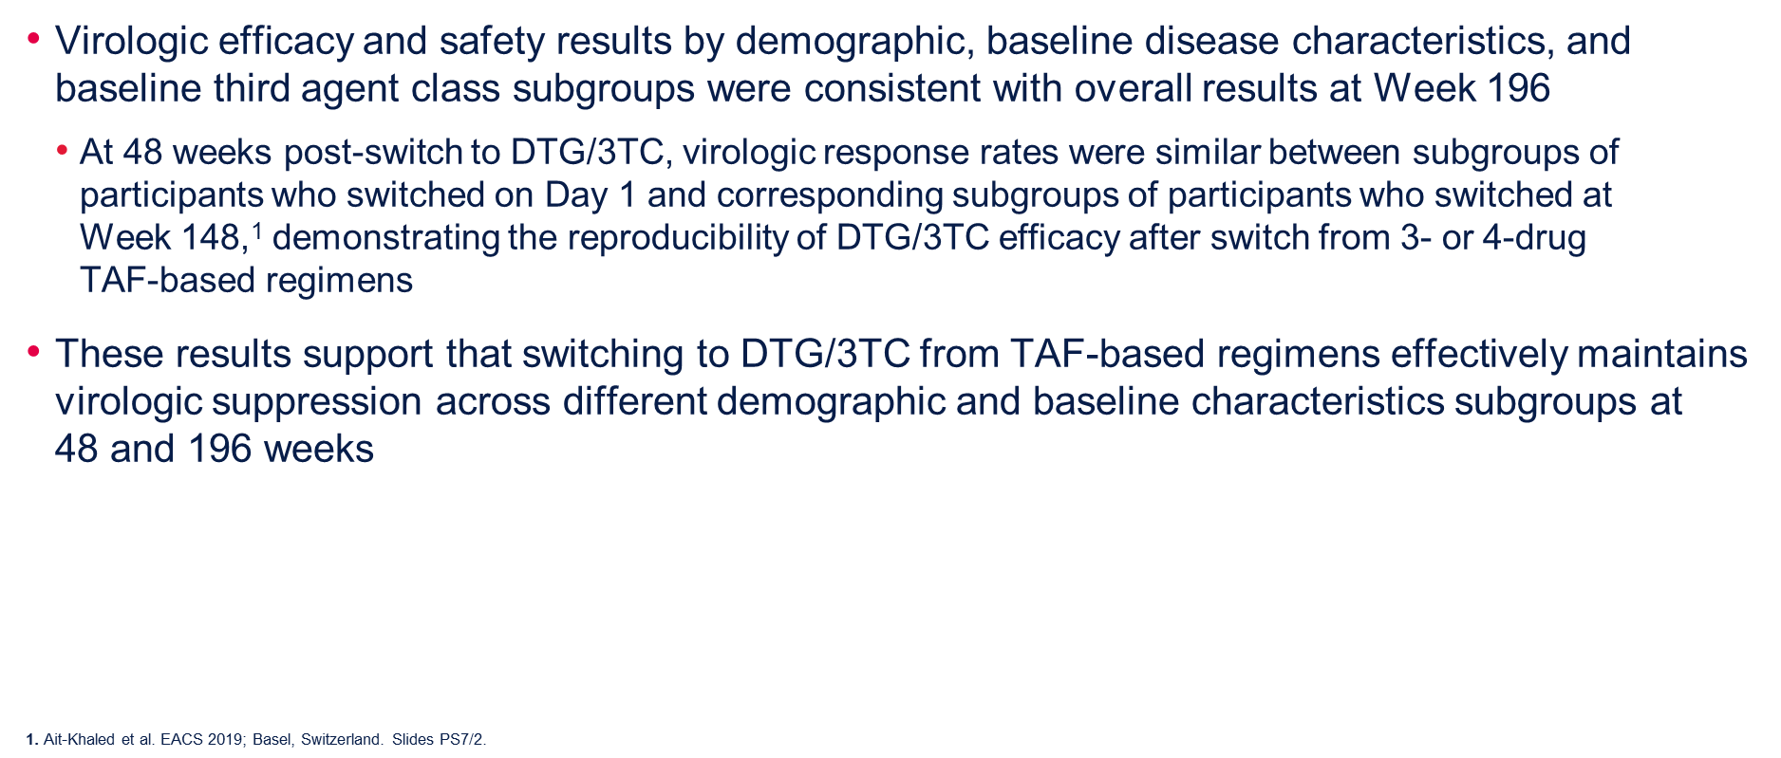
Conclusions TANGO
Referencia: 1. Smith D.E., Routy J.-P., Scholten S., et al. Switching to Dolutegravir/Lamivudine (DTG/3TC) is non-inferior to continuing tenofovir alafenamide (TAF)-based regimens at Week 196: TANGO subgroup analyses. Poster EPB0218. Presentado en IAS 2023, the 12th IAS Conference on HIV Science. 23–26 Julio 2023. Brisbane, Australia. Disponible en: https://www.natap.org/2023/IAS/IAS_27.htm Acceso realizado septiembre 2023

Slide 29
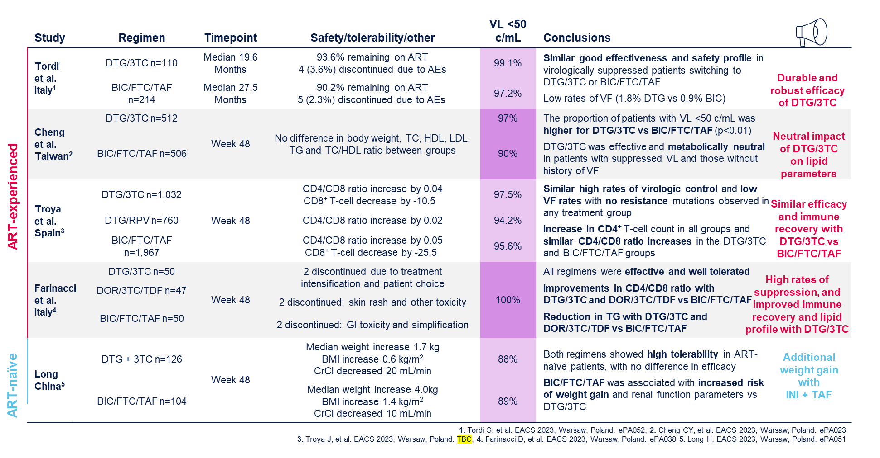
Real-world data shows similar efficacy of DTG/3TC versus BIC/FTC/TAF

Slide 30
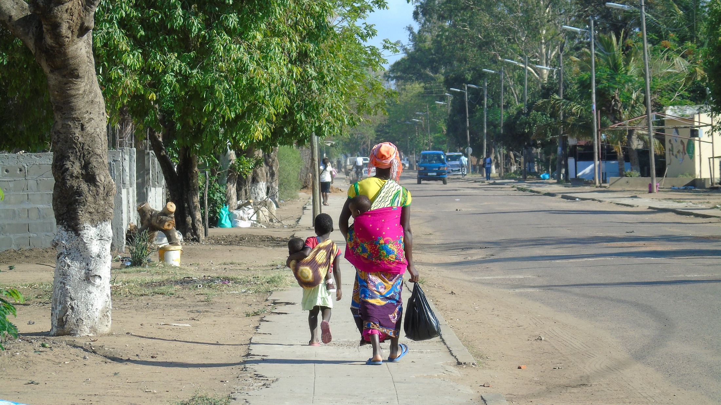
Muchas gracias….

